Slide 1



Sign Language Recognition and Sentence Generation
Using CNN-LSTM
with Attention
Deep Learning Case Study
B. Srijay Ram-160124748095 | B. Shashi Nayak-160124748098
CSE (Artificial Intelligence and Machine Learning)
Chaitanya Bharathi Institute of Technology
2026–27

Slide 2







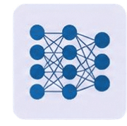






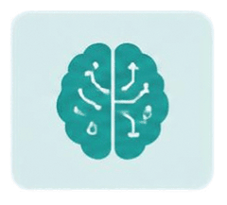



Problem Statement & Motivation
Sign language is
primarily visual and
gesture-based
Manual interpretation requires trained
human interpreters
ASL Hand Sign
Computer Vision
Deep Learning
Recognized
Alphabet / Sign
Computer vision can
recognize visual
hand-sign patterns
Deep learning enables
automatic sign
classification
Hand Sign
AI Model
Recognized Meaning

Slide 3






















Objectives & System Overview
IMPLEMENTED SYSTEM
ASL Hand Image
01
Recognize
individual ASL
hand signs
Extract
meaningful
visual features
02
Preprocessing
ResNet50
Explore
sequential
sign-to-text
generation as a
future extension
Classify the corresponding
alphabet/sign
Feature Extraction
03
04
Classification Head
Predicted Alphabet / Sign

Slide 4


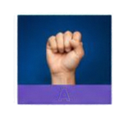
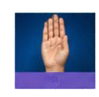
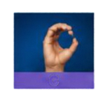
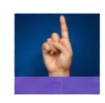
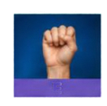
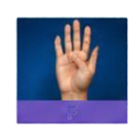

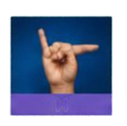


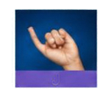

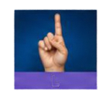


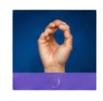
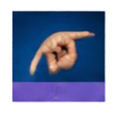


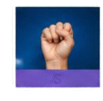

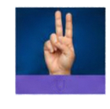

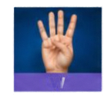
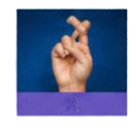

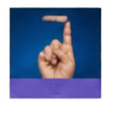
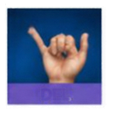
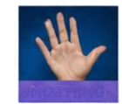
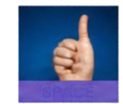


















Dataset & Preprocessing
ASL alphabet and
special classes included
A
B
C
D
E
F
G
H
I
Images resized to required input dimensions
J
K
L
M
N
O
P
Q
R
Pixel values normalized
Data augmentation to
improve generalization
S
T
U
V
W
X
Y
Z
DEL
NOTHING
SPACE
RAW IMAGE
RESIZE
NORMALIZE
AUGMENTATION
MODEL INPUT

Slide 5





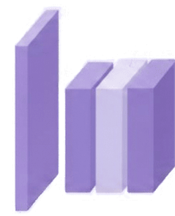


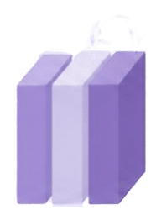











ResNet50-Based Static Sign Recognition
Input ASL Image
ResNet50 is the
pretrained CNN backbone.
Conv
Block
Conv
Block
Preprocessing
Conv Avg Pool
Pretrained ResNet50
Deep convolutional
features capture visual
characteristics of hand signs.
Deep Feature Extraction
Classification Head
The classification head
predicts the corresponding
sign class.
Transfer Learning
Predicted Alphabet / Sign

Slide 6






















Proposed Sequential Sign-to-Text Extension
PROPOSED FUTURE EXTENSION — NOT PART OF THE CURRENT IMPLEMENTATION
Consecutive Sign Frames
Sequence of video frames capturing continuous signs
CNN / ResNet50
Feature Extraction
Visual feature extraction using deep CNN
Feature Sequence
Ordered sequence of
visual feature vectors
LSTM
Temporal sequence
modelling with LSTM
Attention Mechanism
Focuses on relevant
time steps
Text Decoder
Generates words based
on attended context
Generated Sentence
Final recognized
sentence output

Slide 7








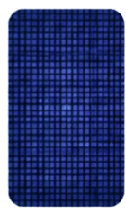
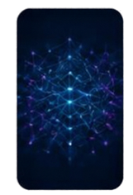
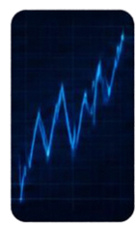





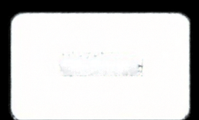
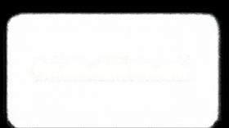

Training and Evaluation
TRAINING PROCESS
EVALUATION METRICS
Dataset
Preprocessing
Training
Validation
Fine-Tuning
Accuracy
Precision
Recall
F1-Score
Confusion Matrix
Cross-entropy
classification loss
Adam
optimizer
Regularization and
training controls
Model checkpointing and
early stopping where applicable

Slide 8

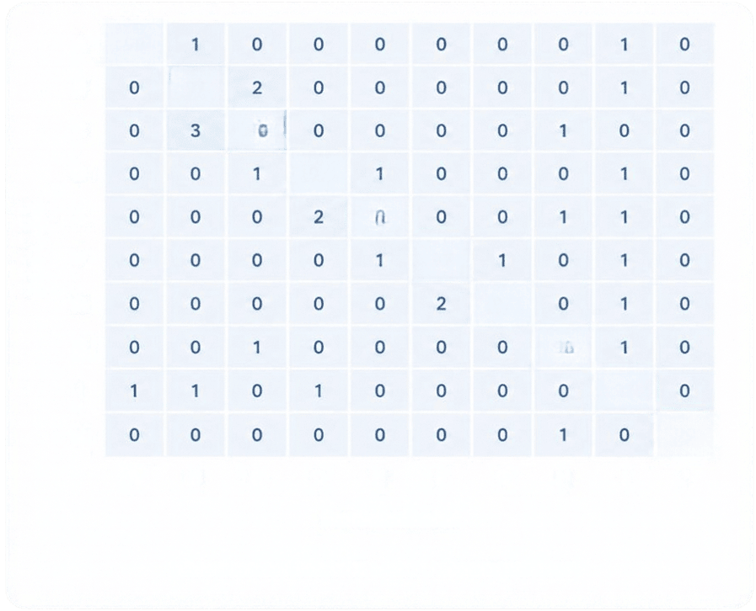












Results & Performance Analysis
A
98
Strong diagonal indicates
correct classification.
B
97
C
96
Most classes show clear
separation.
D
97
E
96
True Label
F
97
Off-diagonal entries represent misclassification.
G
97
H
98
The matrix provides class-wise performance insight.
I
97
J
99
A
B
C
D
E
F
G
H
I
J
Current system predicts individual ASL signs/alphabets from input images.
Predicted Label
Confusion Matrix – ASL Recognition

Slide 9








Conclusion & Future Scope
Conclusion
The implemented system performs static ASL sign/alfabet recognition using a ResNet50-based deep learning model.
Transfer learning enables effective extraction of visual
features for sign classification.
The system provides a foundation for more advanced
continuous sign-language understanding.
Future Scope
01
02
03
04
05
Continuous
Video-Based
Recognition
Word-Level
Sign Recognition
Sentence-Level
Translation
Mobile & Web
Deployment
Multimodal
Sign-Language
Understanding
Move beyond
individual alphabet
symbols
Generate meaningful
sentences from sign
sequences
Enable real-time
practical applications
Recognize consecutive
signs from video
Combine visual,
temporal and
contextual information
Thank You

